Slide 1
Introduction to AI

Slide 2
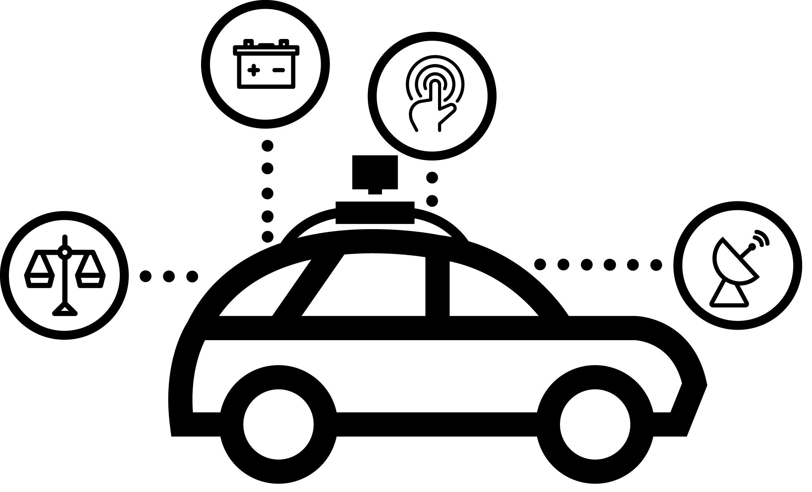

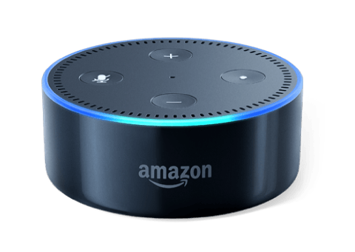


Slide 3
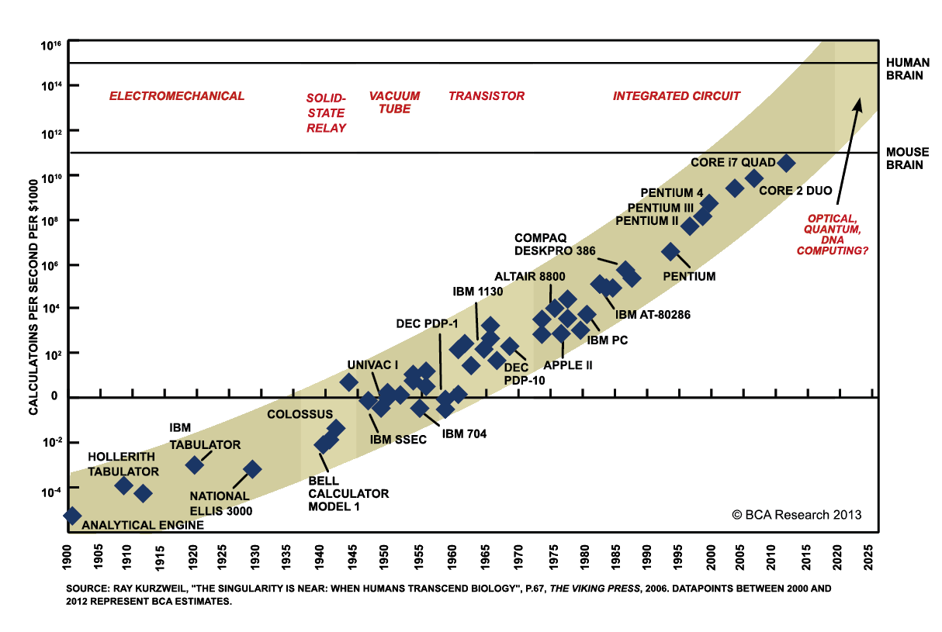
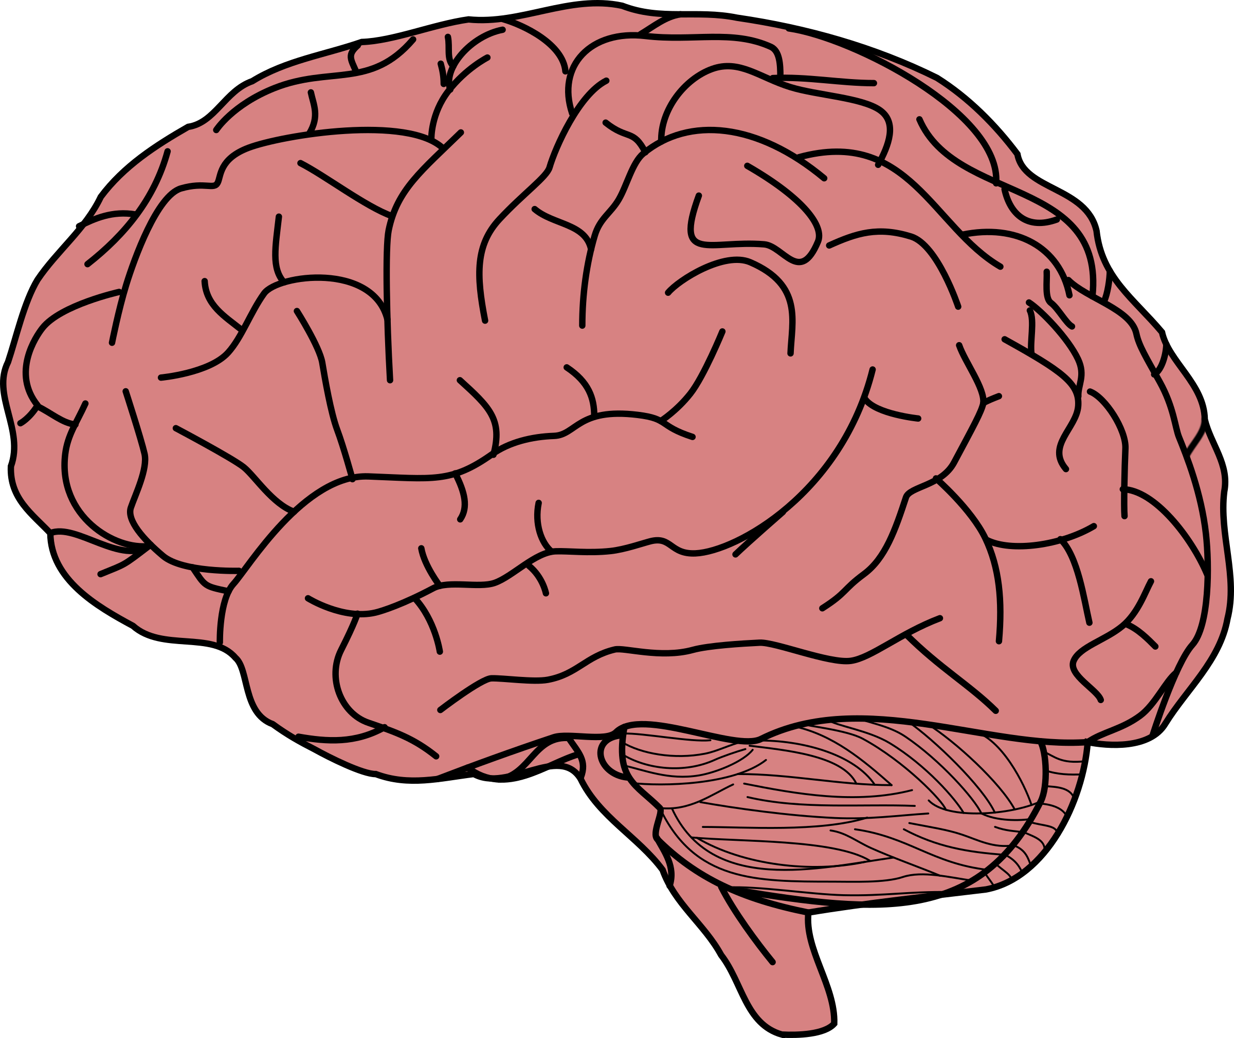

Moore’s Law

Slide 4
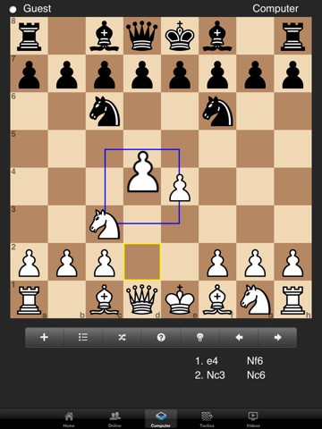
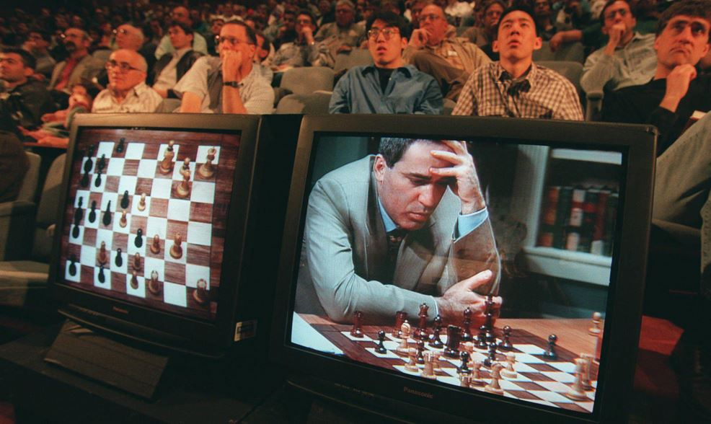

The Scope of Moore’s Law
1997 Deep Blue vs Gary Kasparov

Slide 5
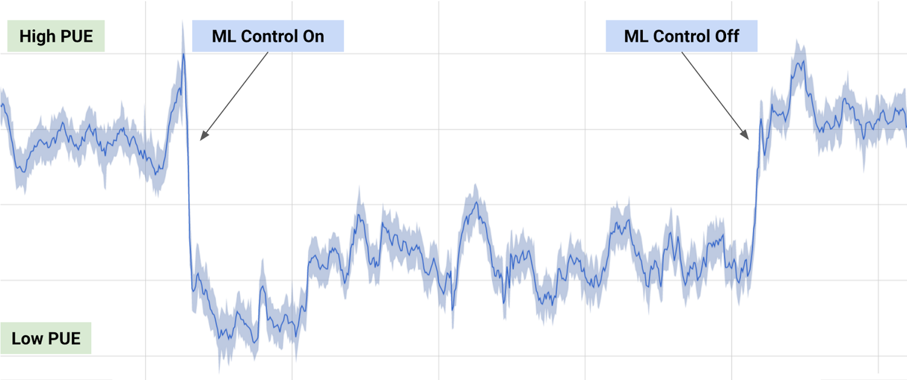

Slide 6
Breaking Down AI
AI
Machine Learning
Deep Learning
Predictive Analytics
Robotics
Speech
Vision
Machine Vision
Image Recognition
Text to Speech
Speech to Text

Slide 7
“Field of study that gives computers the ability to learn without being explicitly programmed”
- Arthur Samuel 1959

Slide 8
How We Do ML
Gather Dataset
Process your Dataset
Build your ML Model
Test Model
Analyze Results

Slide 9
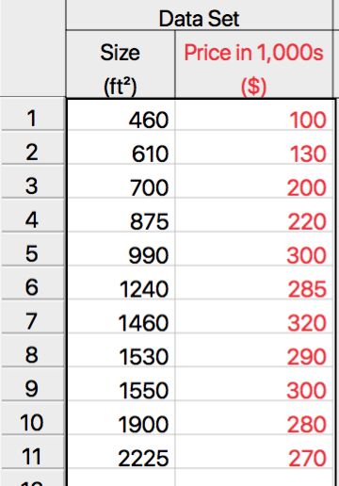
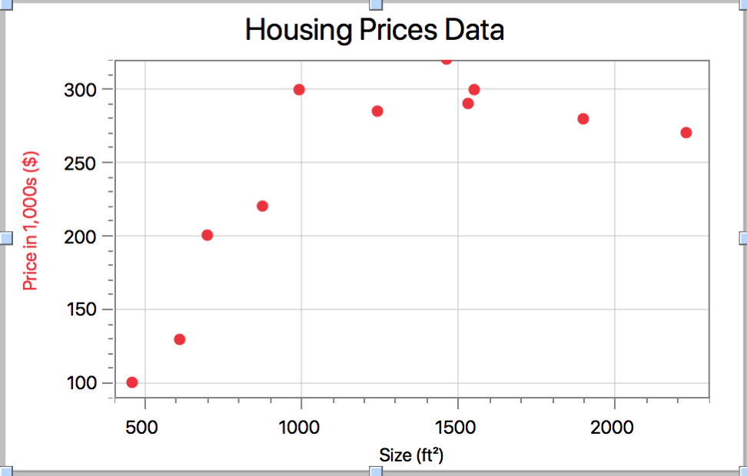
Supervised Learning

Slide 10
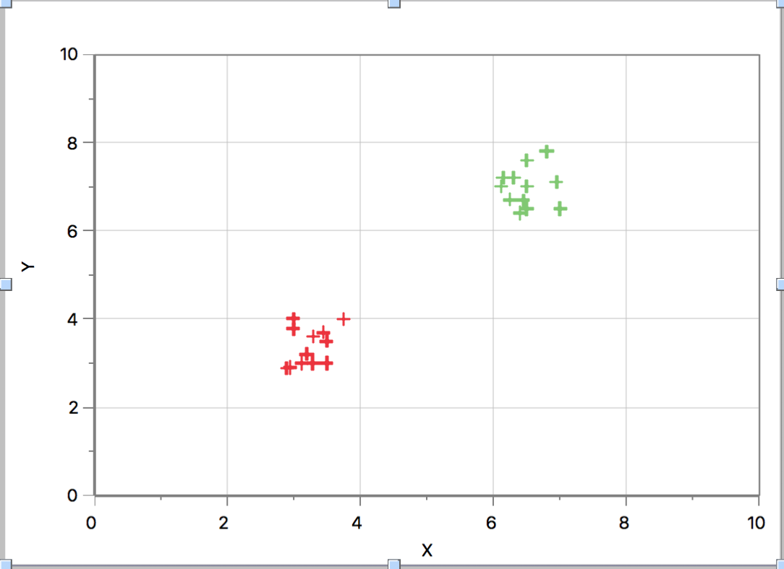
Unsupervised Learning

Slide 11
Structure Of The Lectures
Python for ML
Machine Learning
Deep Learning

Slide 12
Thanks!
Any questions?
Harker AI Club 2018

